Slide 1
Hierarchical Modeling II
Ed Angel
Professor of Computer Science, Electrical and Computer Engineering, and Media Arts
University of New Mexico
Angel: Interactive Computer Graphics 5E © Addison-Wesley 2009

Slide 2
Objectives
Build a tree-structured model of a humanoid figure
Examine various traversal strategies
Build a generalized tree-model structure that is independent of the particular model
Angel: Interactive Computer Graphics 5E © Addison-Wesley 2009

Slide 3
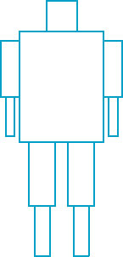
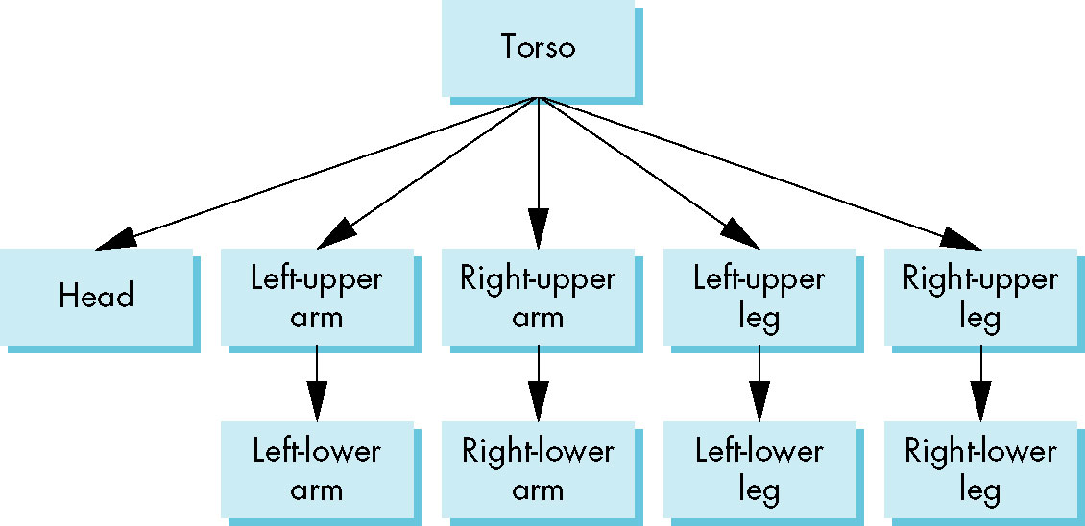
Humanoid Figure
Angel: Interactive Computer Graphics 5E © Addison-Wesley 2009

Slide 4
Building the Model
Can build a simple implementation using quadrics: ellipsoids and cylinders
Access parts through functions
  torso()
  left_upper_arm()
Matrices describe position of node with respect to its parent
  M_{lla} positions left lower leg with respect to left upper arm
Angel: Interactive Computer Graphics 5E © Addison-Wesley 2009

Slide 5
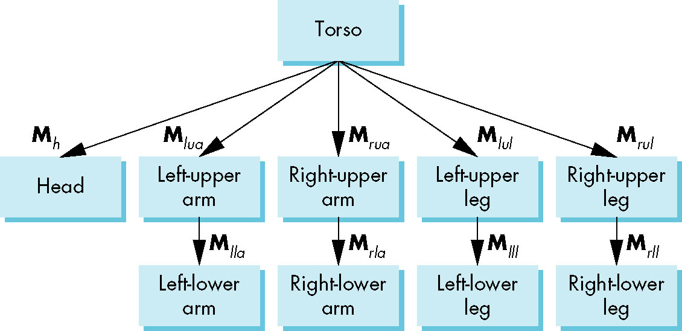
Tree with Matrices
Angel: Interactive Computer Graphics 5E © Addison-Wesley 2009

Slide 6
Display and Traversal
The position of the figure is determined by 11 joint angles (two for the head and one for each other part)
Display of the tree requires a graph traversal
  Visit each node once
  Display function at each node that describes the part associated with the node, applying the correct transformation matrix for position and orientation
Angel: Interactive Computer Graphics 5E © Addison-Wesley 2009

Slide 7
Transformation Matrices
There are 10 relevant matrices
  M positions and orients entire figure through the torso which is the root node
  M_{h} positions head with respect to torso
  M_{lua}, M_{rua}, M_{lul}, M_{rul} position arms and legs with respect to torso
  M_{lla}, M_{rla}, M_{lll}, M_{rll} position lower parts of limbs with respect to corresponding upper limbs
Angel: Interactive Computer Graphics 5E © Addison-Wesley 2009

Slide 8
Stack-based Traversal
Set model-view matrix to M and draw torso
Set model-view matrix to MM_{h} and draw head
For left-upper arm need MM_{lua} and so on
Rather than recomputing MM_{lua} from scratch or using an inverse matrix, we can use the matrix stack to store M and other matrices as we traverse the tree
Angel: Interactive Computer Graphics 5E © Addison-Wesley 2009

Slide 9
Traversal Code
figure() {
glPushMatrix()
torso();
glRotate3f(…);
head();
glPopMatrix();
glPushMatrix();
glTranslate3f(…);
glRotate3f(…);
left_upper_arm();
glPopMatrix();
glPushMatrix();
save present model-view matrix
update model-view matrix for head
recover original model-view matrix
save it again
update model-view matrix
for left upper arm
recover and save original
model-view matrix again
rest of code
Angel: Interactive Computer Graphics 5E © Addison-Wesley 2009

Slide 10
Analysis
The code describes a particular tree and a particular traversal strategy
  Can we develop a more general approach?
Note that the sample code does not include state changes, such as changes to colors
  May also want to use glPushAttrib and glPopAttrib to protect against unexpected state changes affecting later parts of the code
Angel: Interactive Computer Graphics 5E © Addison-Wesley 2009

Slide 11
General Tree Data Structure
Need a data structure to represent tree and an algorithm to traverse the tree
We will use a left-child right sibling structure
  Uses linked lists
  Each node in data structure is two pointers
  Left: next node
  Right: linked list of children
Angel: Interactive Computer Graphics 5E © Addison-Wesley 2009

Slide 12
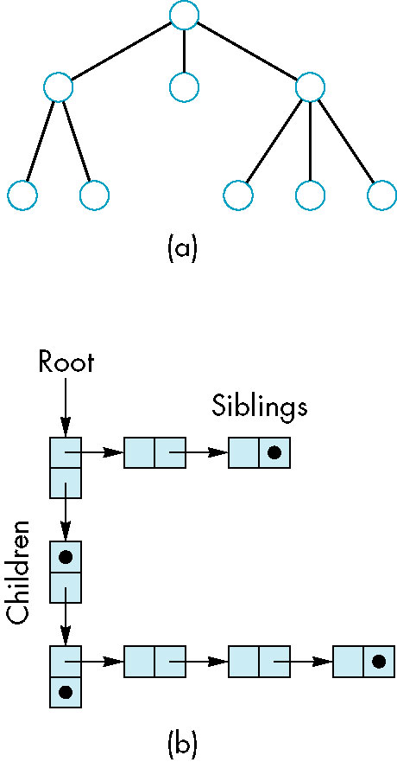
Left-Child Right-Sibling Tree
Angel: Interactive Computer Graphics 5E © Addison-Wesley 2009

Slide 13
Tree node Structure
At each node we need to store
  Pointer to sibling
  Pointer to child
  Pointer to a function that draws the object represented by the node
  Homogeneous coordinate matrix to multiply on the right of the current model-view matrix
    Represents changes going from parent to node
    In OpenGL this matrix is a 1D array storing matrix by columns
Angel: Interactive Computer Graphics 5E © Addison-Wesley 2009

Slide 14
C Definition of treenode
typedef struct treenode
{
GLfloat m[16];
void (*f)();
struct treenode *sibling;
struct treenode *child;
} treenode;
Angel: Interactive Computer Graphics 5E © Addison-Wesley 2009

Slide 15
Defining the torso node
treenode torso_node, head_node, lua_node, … ;
/* use OpenGL functions to form matrix */
glLoadIdentity();
glRotatef(theta[0], 0.0, 1.0, 0.0);
/* move model-view matrix to m */
glGetFloatv(GL_MODELVIEW_MATRIX, torso_node.m)
torso_node.f = torso; /* torso() draws torso */
Torso_node.sibling = NULL;
Torso_node.child = &head_node;
Angel: Interactive Computer Graphics 5E © Addison-Wesley 2009

Slide 16
Notes
The position of figure is determined by 11 joint angles stored in theta[11]
Animate by changing the angles and redisplaying
We form the required matrices using glRotate and glTranslate
  More efficient than software
  Because the matrix is formed in model-view matrix, we may want to first push original model-view matrix on matrix stack
Angel: Interactive Computer Graphics 5E © Addison-Wesley 2009

Slide 17
Preorder Traversal
void traverse(treenode *root)
{
if(root == NULL) return;
glPushMatrix();
glMultMatrix(root->m);
root->f();
if(root->child != NULL)
traverse(root->child);
glPopMatrix();
if(root->sibling != NULL)
traverse(root->sibling);
}
Angel: Interactive Computer Graphics 5E © Addison-Wesley 2009

Slide 18
Notes
We must save model-view matrix before multiplying it by node matrix
  Updated matrix applies to children of node but not to siblings which contain their own matrices
The traversal program applies to any left-child right-sibling tree
  The particular tree is encoded in the definition of the individual nodes
The order of traversal matters because of possible state changes in the functions
Angel: Interactive Computer Graphics 5E © Addison-Wesley 2009

Slide 19
Dynamic Trees
If we use pointers, the structure can be dynamic
typedef treenode *tree_ptr;
tree_ptr torso_ptr;
torso_ptr = malloc(sizeof(treenode));
Definition of nodes and traversal are essentially the same as before but we can add and delete nodes during execution
Angel: Interactive Computer Graphics 5E © Addison-Wesley 2009

